Slide 1


UNIVERSITY MANAGEMENT SYSTEM
MINI PROJECT – 1
BATCH – 35
CSE DEPARTMENT
PROJECT GUIDE:
Mr. G. RAVI KUMAR
PRESENTED BY:
19H51A05A0 –CH.HARSHITHA
19H51A05A1 –G.VAMSHI
19H51A05C1 –y.aRCHANA

Slide 2

TABLE OF CONTENTS
ABSTRACT
INTRODUCTION
OBJECTIVE
PROPOSED SYSTEM
REQUIREMENT ANALYSIS
SOFTWARE REQUIREMENTS
IMPLEMENTATION
OUTPUT
CONCLUSION
ADVANTAGES
REFERENCES

Slide 3

ABSTRACT
Every University/College/Organization, regardless of being big or small have challenges to overcome in managing the information of Students, Faculty, Courses, Fee structure, Attendance etc... at the management level. In this fast-growing world everything depends on the data, so people are tending to give more importance for the security of the data. As the technology is growing rapidly, everything is expected to be automatic with less labor force. Hence, we produced an idea of developing an application called “UNIVERSITY MANAGEMENT SYSTEM” which deals with the maintenance of University data, records, instructions, and students’ information within the University.
UMS is an automation system, which is used to store the information, students record, and information of courses. Starting from registration of a new student in the college, it maintains all the details regarding the attendance and marks of the student. It collects related information from all the departments of an organization and maintains files, which are used to generate reports in various forms to measure Individual and overall performance of the students.

Slide 4
INTRODUCTION
UNIVERSITY MANAGEMENT SYSTEM (UMS) is a flagship product of Easy Solution which covers all aspects of Universities, Colleges or Schools. UMS covers every minute aspects of a universities workflow and integrates all processes with user friendly interface. UMS streamline path of information flow in organization by taking care of following departments:
Fee Department
Examination Department
Attendance
Faculty information portal
Student information portal

Slide 5
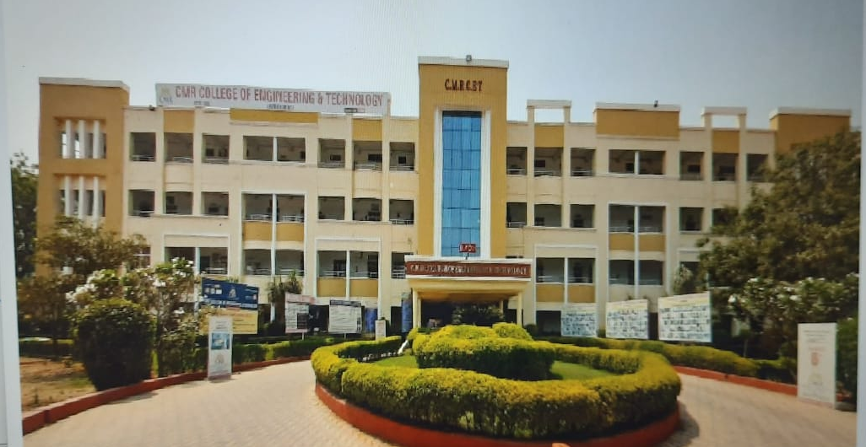
OBJECTIVE
The main objective of the proposed university management system is to computerize the existing system and reduce manpower and time consumption.

Slide 6
EXISTING SYSTEM
The system starts with registration of new staff and students.
When the subjects are to be allocated to the faculty, the Head of the Department should enter everything in the Excel sheets.
Then the staff enters corresponding subject’s attendance and marks of a student then those must also be entered in the Excel sheets and validations are to be done by the user itself.
So, there will be a lot of work to be done and must be more conscious during the entrance of details. So, more risk is involved.

Slide 7
PROPOSED SYSTEM
UMS (UNIVERSITY MANAGEMENT SYSTEM) makes management to get the most updated information always by avoiding manual accounting process.
This system has the following functional divisions. University Administrator/College Administrator User (Students / Faculties)University Administrator has the functionality of registering new colleges and courses.
Helps to display all the departments with its respective fee structure.
User will be the administrator. Admin has the facility of entering the marks and attendance of the students.
Reports must be generated for the existing data i.e., for attendance of the students, which are used to assess the performance of the students. These reports should be viewed by the admin and can be shared.

Slide 8
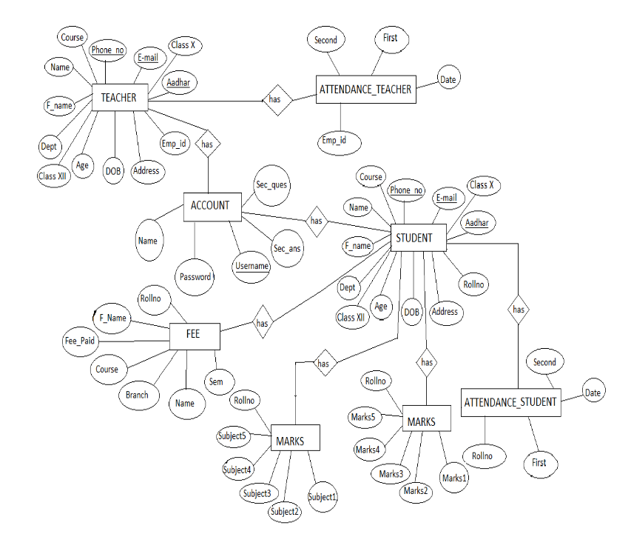
REQUIREMENT ANALYSIS
E-R DIAGRAM:

Slide 9
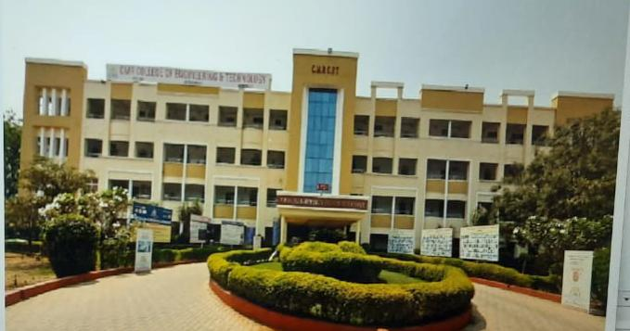
SOFTWARE REQUIREMENTS
Operating system : Windows 11
Application server : JAVA (NetBeans)
(Version 12.5)
Front end : JAVA
(Version 17.0.1)
Connectivity : JDBC Driver
Database connectivity : WAMP (MYSQL Console)
(Version 5.7.31)

Slide 10
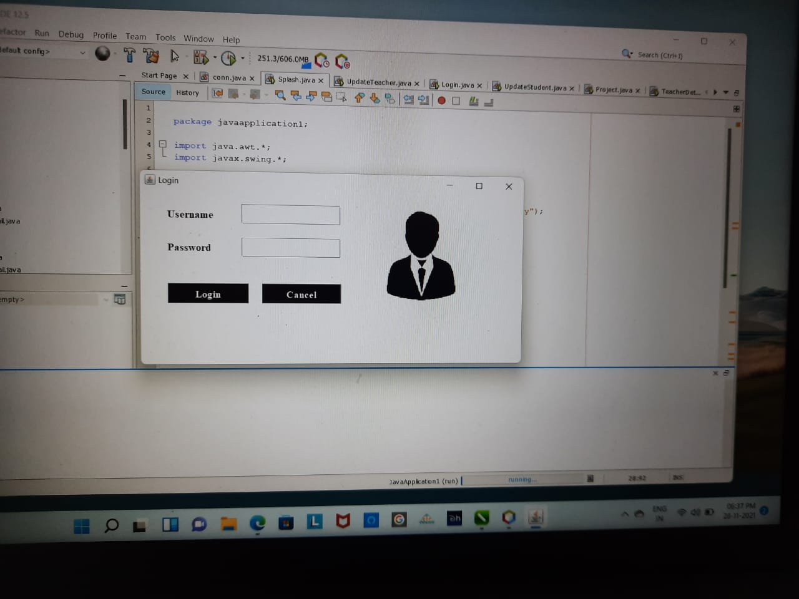
IMPLEMENTATION

Slide 11
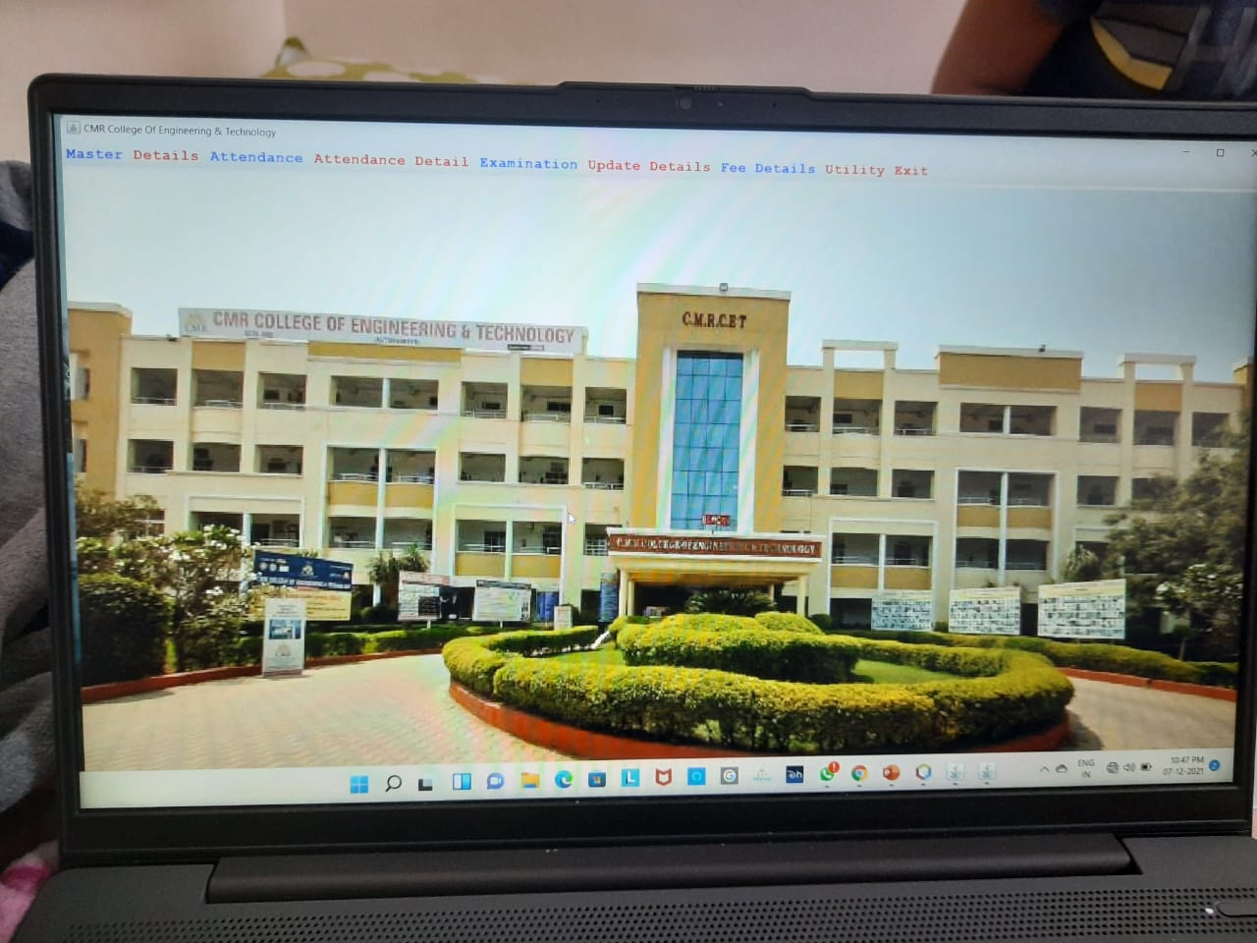

Slide 12
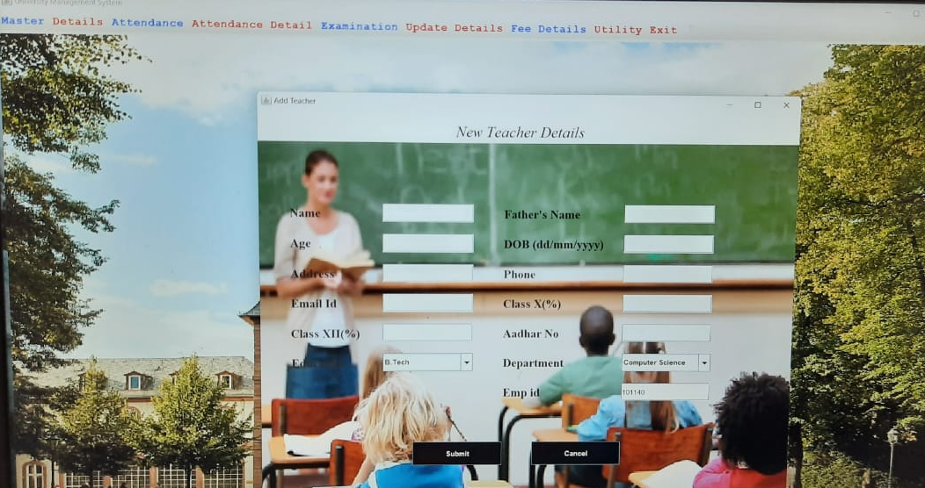

Slide 13
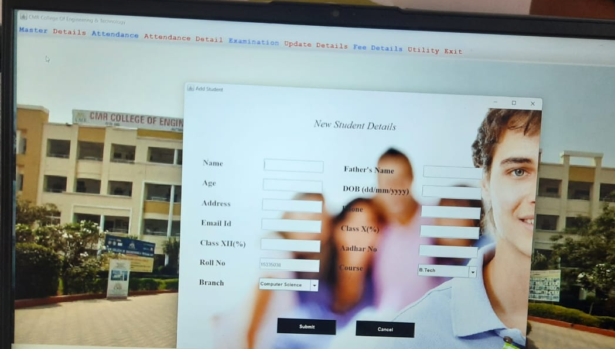

Slide 14
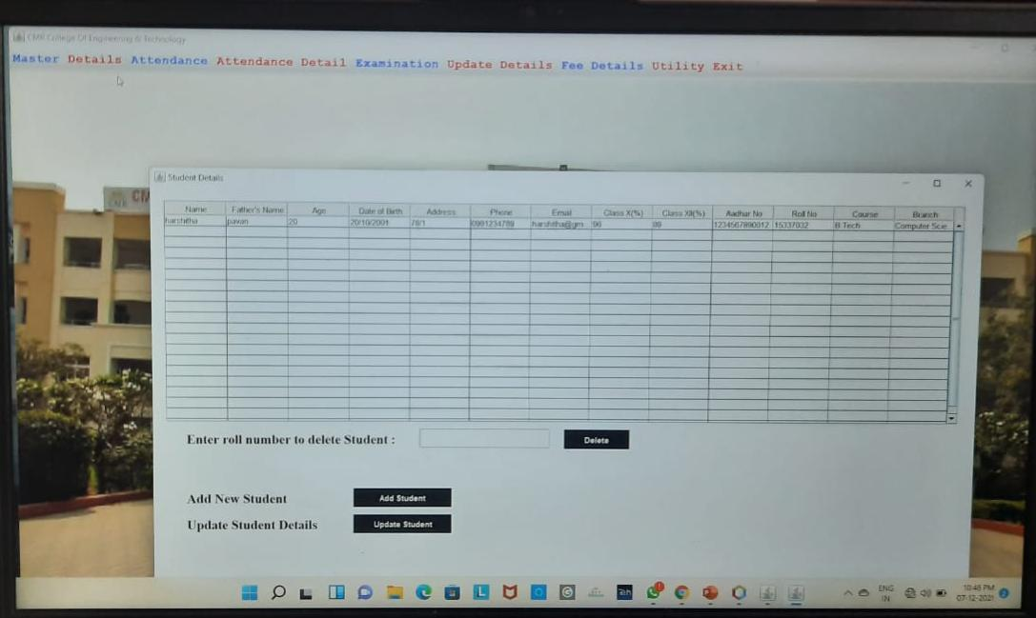

Slide 15
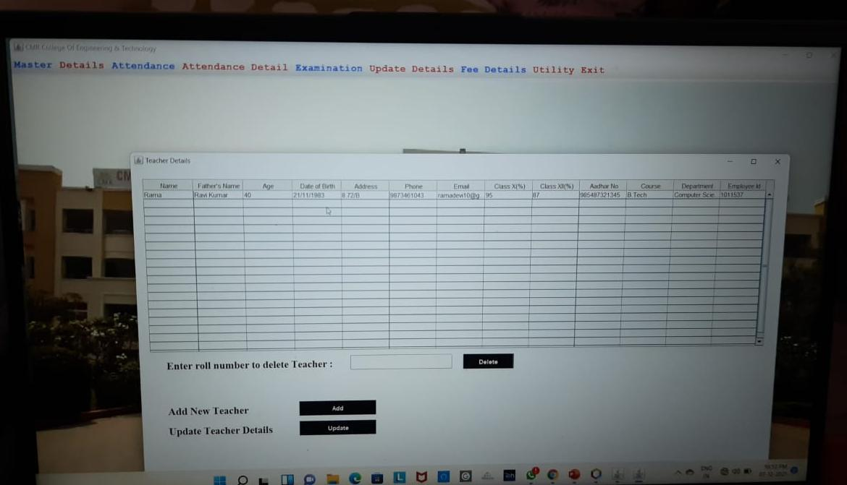

Slide 16
ADVANTAGES
Self-service systems with simple to use with little or no training.
Elimination of duplicate data entry processes.
Monitoring and decision support system.
Automation of all the Academic / Examination / Administration operations.
Ease and accuracy of reporting.
Provides a quick, accurate and timely query response system.
Help management in decision making.

Slide 17
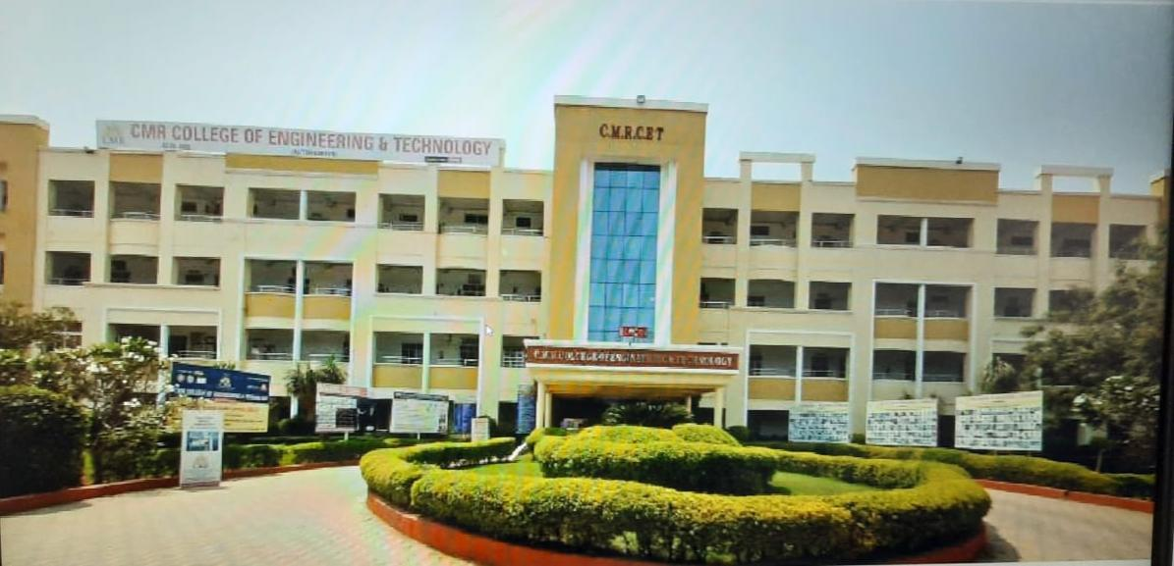
CONCLUSION
The project entitled as University Management System is the system that deals with the issues related to a particular institution. It is successfully implemented with all the features mentioned.
The application provides appropriate information to users according to the chosen service.
The project is designed keeping in view the day-to-day problems faced by a college.
Deployment of our application will certainly help the college to reduce unnecessary wastage of time in personally going to each department for some information.
Awareness and right information about any college is essential for both the development of student as well as faculty. So, this serves the right purpose in achieving the desired requirements of both the communities.

Slide 18

REFERENCES
Internet & World Wide Web: How to Program Deitel, PJ Deitel.
Thinking in Java, Bruce Eckel, Pearson Education.
Object Oriented Programming through java, P. Radha Krishna,Universities Press.
Code for Interview YouTube Channel.
Database System Concepts, by Silberschatz, Sudarshan, and Korth.
https://github.com/topics/university-management

Slide 19

THANK YOU

